Slide 1
Example of Drawing Confidence interval
x=c(1,2,3,4,5,6,7,8,9,0)
y=c(13,28,43,35,96,84,101,110,108,13)
lm.out <- lm(y ~ x)
summary(lm.out)
newx = seq(min(x),max(x),by = 0.05)
conf_interval <- predict(lm.out, newdata=data.frame(x=newx), interval="confidence",
level = 0.95)
plot(x, y, xlab="x", ylab="y", main="Regression")
abline(lm.out, col="lightblue")
lines(newx, conf_interval[,2], col="blue", lty=2)
lines(newx, conf_interval[,3], col="blue", lty=2)

Slide 2
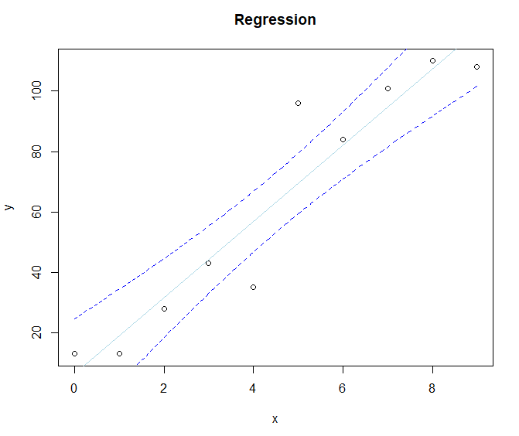

Slide 3
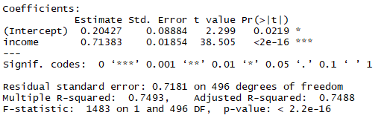
Relationship between income and happiness
https://www.scribbr.com/statistics/simple-linear-regression/
You are a social researcher interested in the relationship between income and happiness. You survey 500 people whose incomes range from $15k to $75k and ask them to rank their happiness on a scale from 1 to 10.
> income.data <- read.csv("C:\\income.data.csv", header=T)
> income.happiness.lm <- lm(happiness ~ income, data = income.data)
> summary(income.happiness.lm)

Slide 4
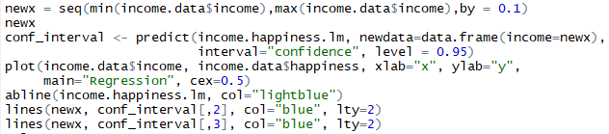
Relationship between income and happiness
> income.happiness.lm$coefficients
(Intercept) income
0.2042704 0.7138255
Y= 0.2042704 + 0.7138255 x income
The graph of the confidence interval :

Slide 5
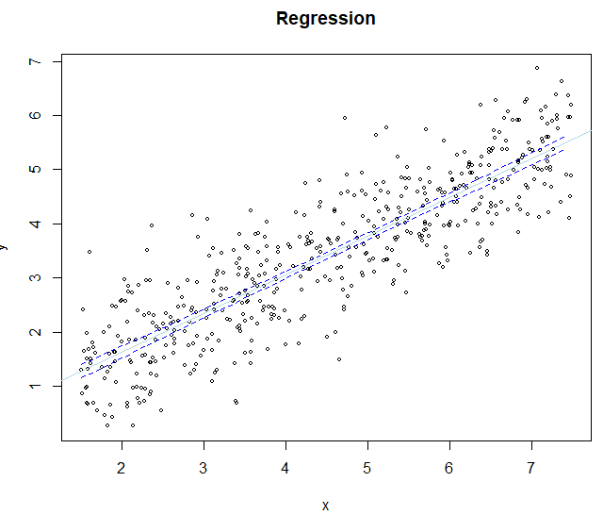
Relationship between income and happiness

